Slide 1
Outline
Introduction to ECR ion source principles
ECR ion source for 50 KeV KACST ion beam line
Modelling results
Commissioning at different beam energies
Conclusion and future work
MODELING OF COMPACT ECR ION SOURCE FOR ELECTROSTATIC STORAGE RING AT KACST Aljazi Alsubaie
Princess Nourah University
Physics Bachelor Graduate

Slide 2
Outline
ELASR Facility at KACST
KACST ECR Ion Source
Injection Beamline
Commissioning Results
Conclusion

Slide 3
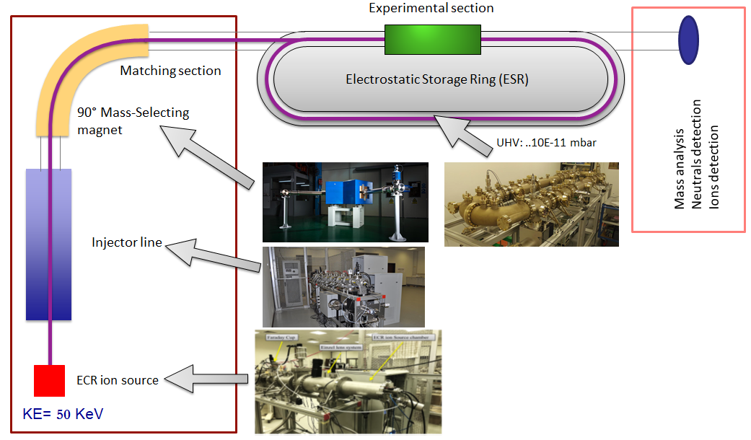
ELectrostAtic Storage Ring (ELASR) Facility
The ESR is the core machine for ELASR Facility at KACST.
ESR was designed and built in 2012.
First vacuum test for the ESR was at the end of 2019.
Magnetic analyzer of high resolution was installed 2019.
The first commissioning benchmark tests of ECR ion source was in 2021.

Slide 4
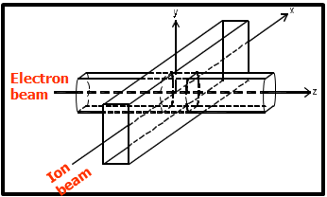
Motivations for ELASR
Introducing ion beam physics technology …
Multi-purpose facility for interdisciplinary applications (surface materials studies….)
Electron or a laser interaction with a gas-phase ion (merged-beams and crossed beams techniques)

Slide 5
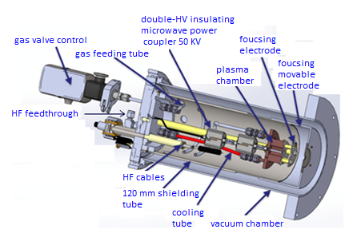
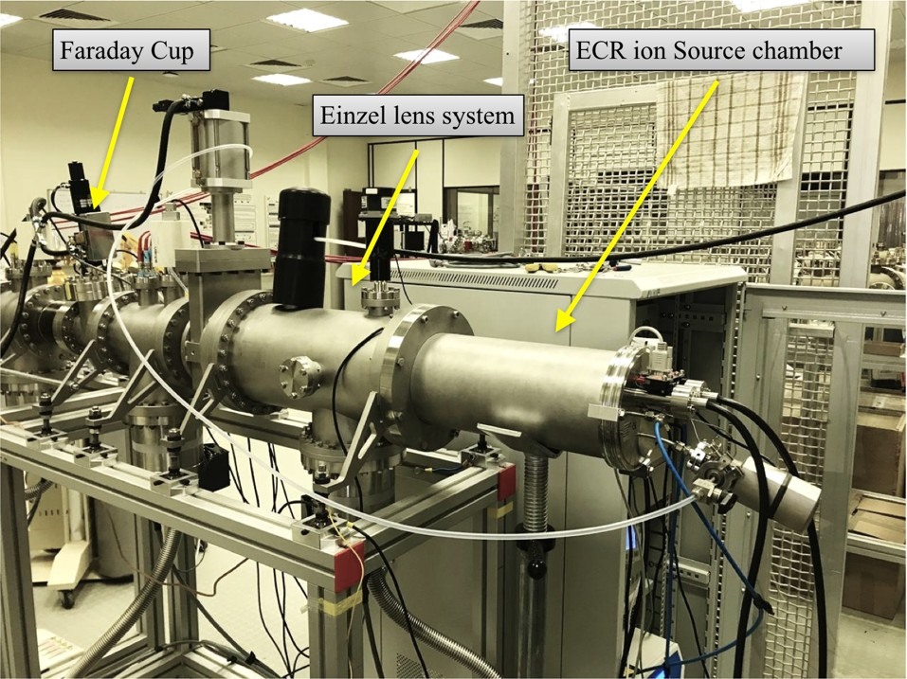
Electron Cyclotron Resonance (ECR) Ion Source for ELASR
ECR ion source makes use of the electron cyclotron resonance to ionize a plasma.
ECR ion source was mounted along the axis of the beamline in a separate vacuum chamber.
The geometry of the ECR plasma chamber was chosen to be as compact as possible.
The main components of the ECR ion source are:
Plasma chamber and vacuum system.
Solenoid magnet for axial confinement of the plasma .
Gas injection port to ionize the neutral atoms or molecules.
RF power input with appropriate frequency which is the source of energy for the electrons.
Ion extraction system for the ion beam formation.

Slide 6
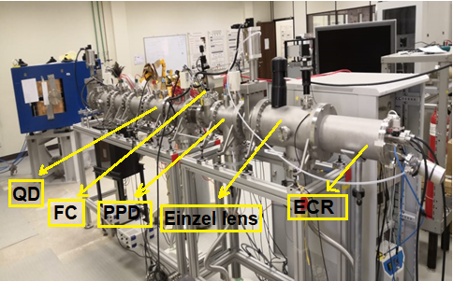
Layout of ESR Injection Beamline
The main optical components are:
Einzel lens is to focus the extraction beam without
changing the beam energy.
Parallel Plate Deflector (PPD) is to correct the beam trajectories in both planes.
Doublet Quadrupole (QD) is to focus the beam in one plane
and defocus in another plane.
Faraday Cup (FC) is to collect the ion beam and measure
the resulting beam current.

Slide 7
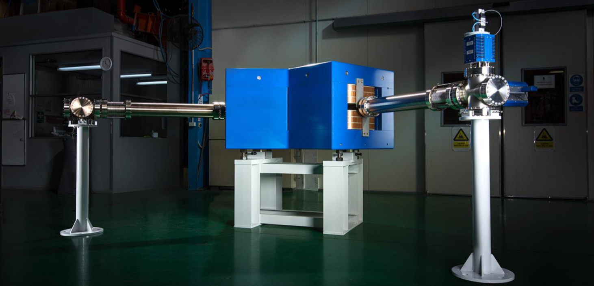
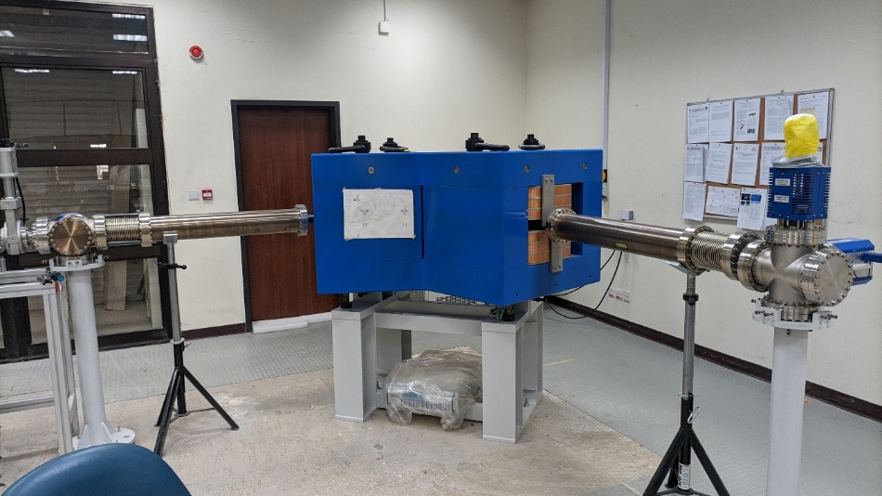
High-resolution analyzing magnet system
Charged Particle Beam
Ion Mass | up to 1500 amu
Ion Charge State | +1
Maximum K.E | 50 keV
Magnet
Type | Analyzing Dipole
Mass Resolution | Δm/m = 1/1500
Bend Angle | 90°
Bend Radius | 1000 mm
Magnet Gap | 50 mm
Max Magnet Gap Field | ~1.25 Tesla
At the end position
Slits
Aperture | 1 mm Horizontal, 50 mm Vertical
Locations Relative to Magnet | 1500 mm

Slide 8
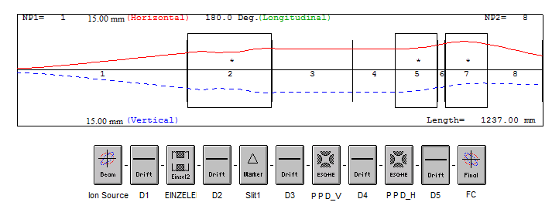
Commissioning Results : Modeling
The ion beam envelop tracked through the ion beamline axis using PBO-Lab software code.
A reasonable results for this modeling were obtained as shown in the below plot.

Slide 9
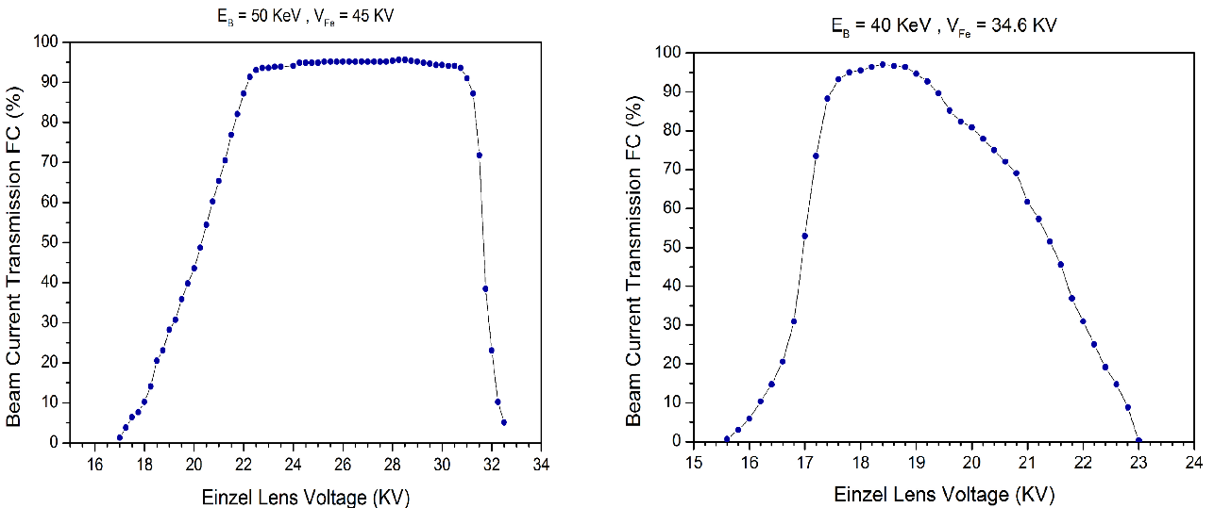
Commissioning Results : Experimental
The first commissioning with the new ECR ion source was reported at two different beam
energies 40 and 50 KeV.
More than 95 % transmission of the extracted beam form ion source was achieved with
good temporal stability.

Slide 10
Conclusion
The ECR ion source is tested and operated at different beam energies.
The ions beam injector system is commissioned and ready to deliver a low energy beam to the magnetic analyzer.
The magnetic analyzer system is mounted and under operating phase.
The next step is to use the mass analyzer to separate the ions.
Further more bench mark tests will be don with this new ion source.

Slide 11
Thank you for your attention

