Slide 1
The Promising Use of Volcanic Silica Rocks as an Environmental Source for Diagnostic X-ray Shielding Applications
Dr. Mohammed Damoom
Nuclear Engineering Department
King Abdulaziz University

Slide 2
Contents
Introduction
Motivation and Objectives
Methodology
Results and Discussion
Conclusion

Slide 3
Introduction

Slide 4
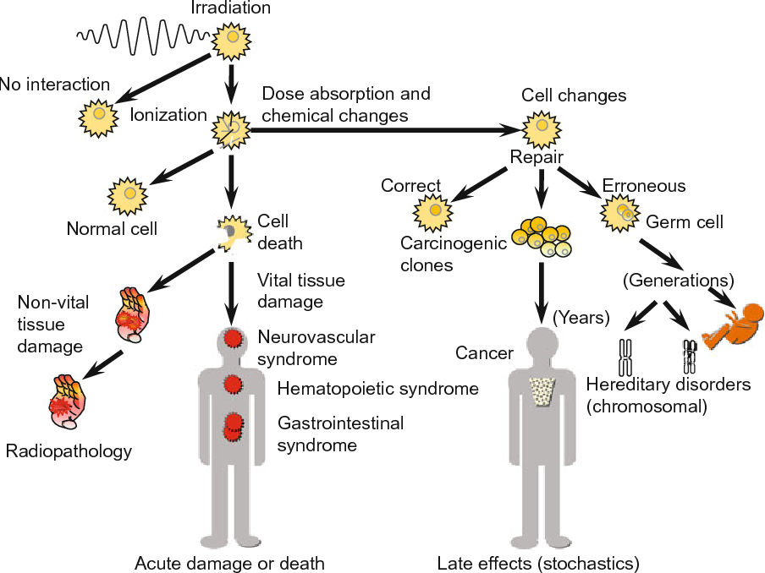
Why Ionizing Radiation Dangerous?
Source: Clinical proceedings - Children's Hospital of the District of Columbia 1961.

Slide 5
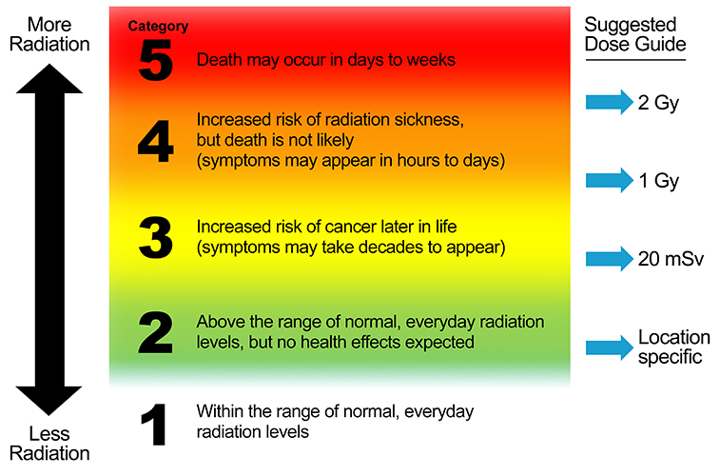
Radiation Hazard Scale
Source: Centers for Disease Control and Prevention

Slide 6
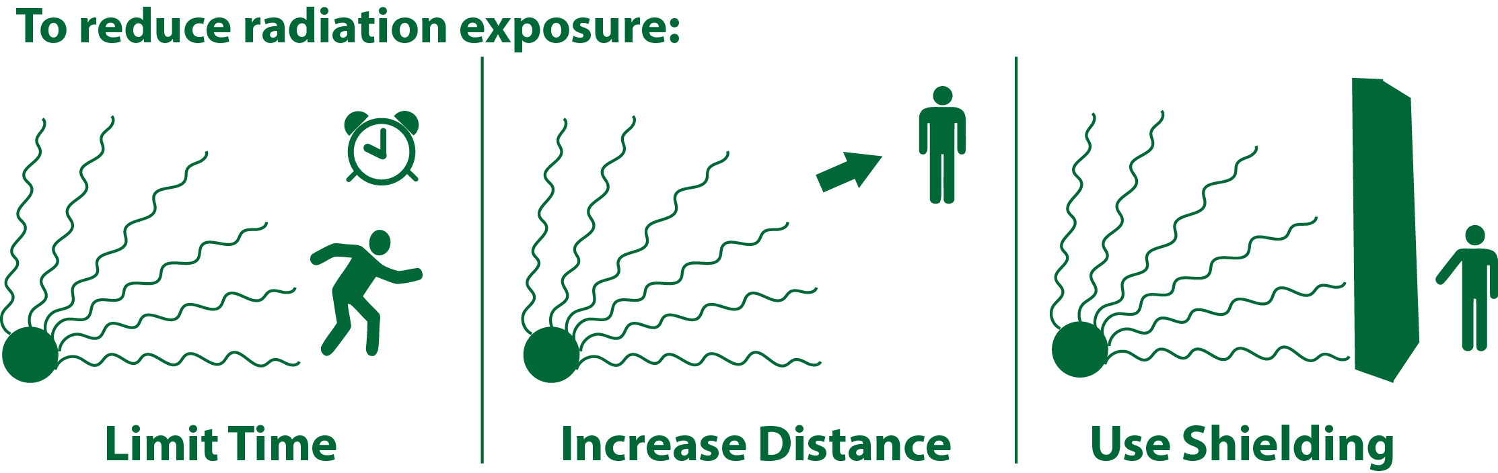
Reducing Radiation Hazard
Source: US EPA

Slide 7
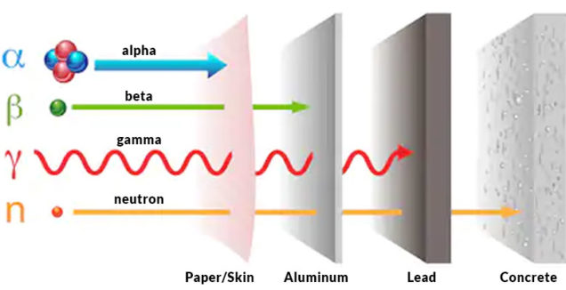
Shielding Materials
Source: MarShield

Slide 8
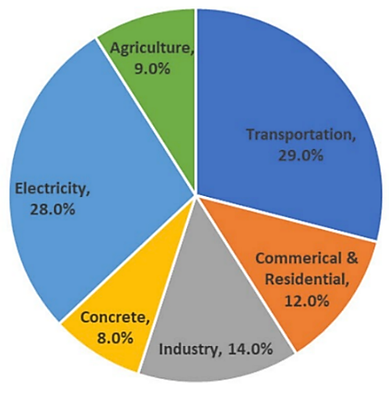
Concrete and CO₂ Emission
Source: psci.princeton.edu

Slide 9
Motivation and Objectives

Slide 10
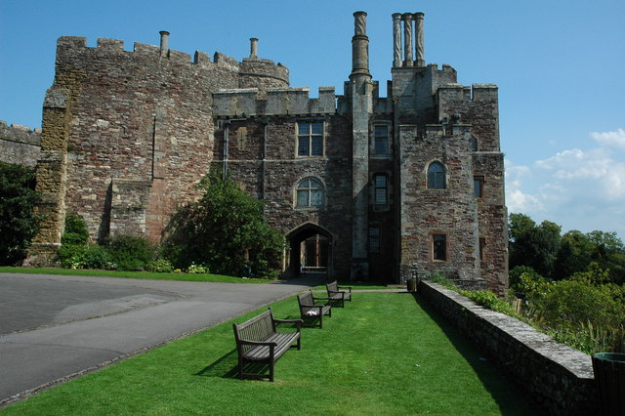
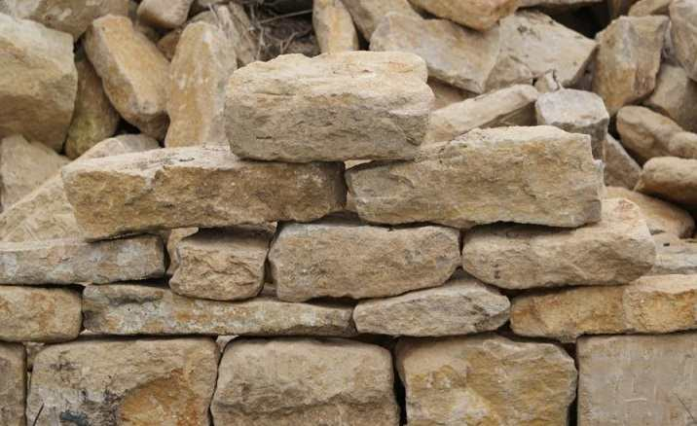
Motivation
Replacing concrete with natural building materials will help reduce CO₂ emissions.
Berkeley Castle, UK.
The castle's origins date back to the 11th century
Stones last for a very long time (1000s years) compared to concrete (50 to 100 years).

Slide 11
Objectives
Investigating the shielding properties of VSRs against diagnostic x-rays.
Comparing the radiation shielding properties of VSRs to that of concrete.

Slide 12
Methodology

Slide 13
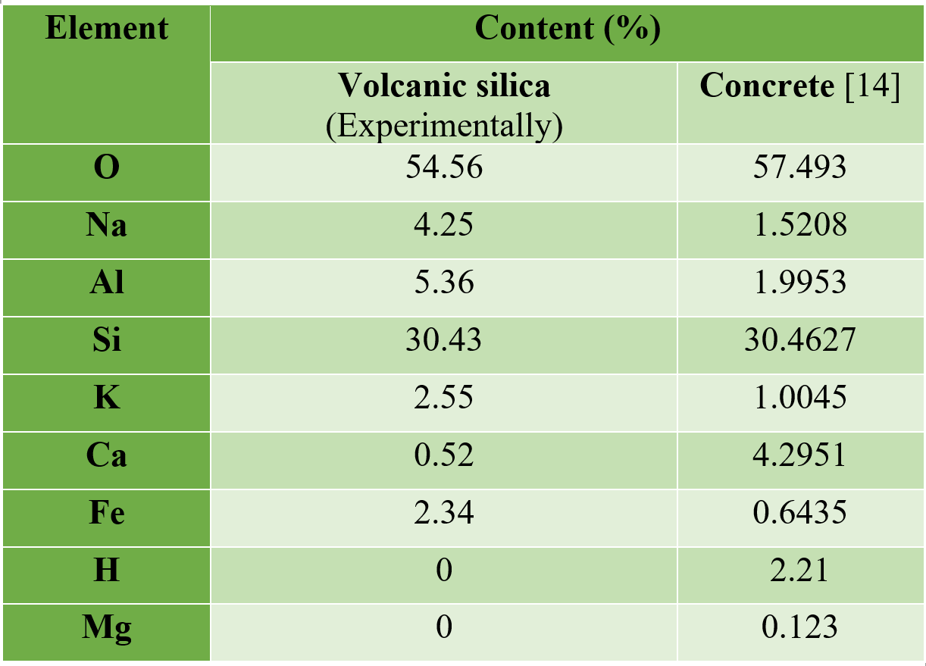
Material Composition
Using the EDX analysis, the elemental compositions of volcanic silica and ordinary concrete were determined.

Slide 14
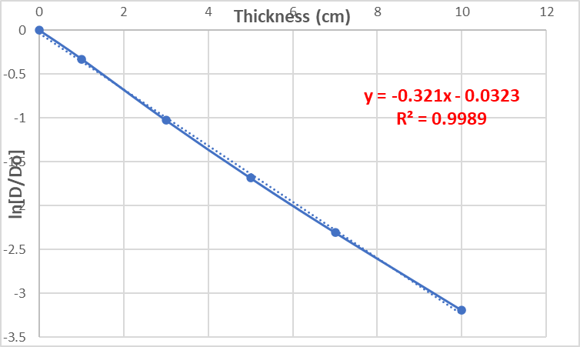
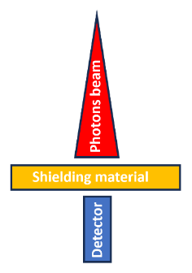
Setup and Procedures

Slide 15
Results and Discussion

Slide 16
Mass Attenuation Coefficients
The figure shows that the mass attenuation coefficient values of VSR are almost as same as that of concrete.

Slide 17
Mass Absorption Coefficients
The figure shows that the mass absorption coefficient values of VSR are almost as same as that of concrete.

Slide 18
Half-Value Layer
The figure shows that the HVLs values of VSR and concrete are almost the same in low energies .
They are a little bit different in large energies.

Slide 19
Mean Free Path
The figure shows that the MFP values of VSR and concrete are almost the same in low energies .
They are a little bit different in large energies.

Slide 20
Variance
VSR = Volcanic Silica Rocks
Conc = Concrete
Variance for both materials are close to each other

Slide 21
Conclusion

Slide 22
Conclusion
The VSR can be used instead of concrete to shield against diagnostic x-rays.
The thickness better to be 15 cm or more

