Slide 1
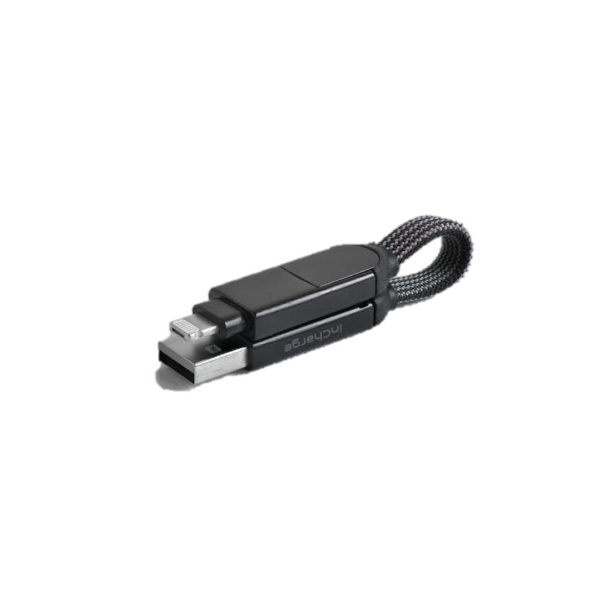
IMPORTANT REMINDER:
Please bring your presentation file on a USB drive to connect to the laptop in the session room.
Before presenting at the meeting, please delete this slide by selecting it in the left sidebar and clicking “Delete.”

